Slide 1
Ulwazi malunga nolwaluko lwamadoda kunye nokuzikhusela kwi HIV

Slide 2
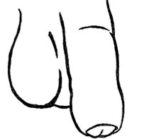
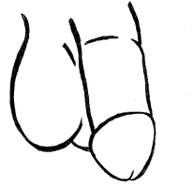
Yintoni ulwaluko Lwamadoda?
Igama
“ulwaluko lwamadoda”
libhekisa ekusikweni kwe jwabu kwilungu lobudoda.
Notes:
Elizweni jekelele, ulwaluko lenziwa ngenxa yenkolo, amasiko, ezempilo kunye nezinye izizathu. Malunga ne 30% yamadoda kumhlaba wonke olukile.

Slide 3
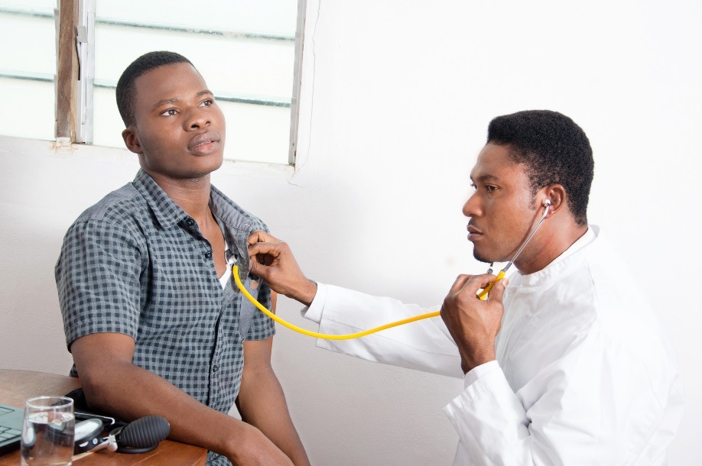
Igama “ulwaluko lwamadoda lwesesibhedlele” libhekisa kutyando lokususa ujwabu ngabezempilo abaqeqeshiweyo.
Yintoni ulwaluko Lwamadoda?
Notes:
Zikhona ezinye indlela zokwaluko, ezibizwa “nje ngesiko lolwaluko”, ezifaka indlela ezithile zokusika ujwabu, amaxesha amaninzi lenziwa ngabantu abange ngabo oozempilo.

Slide 4
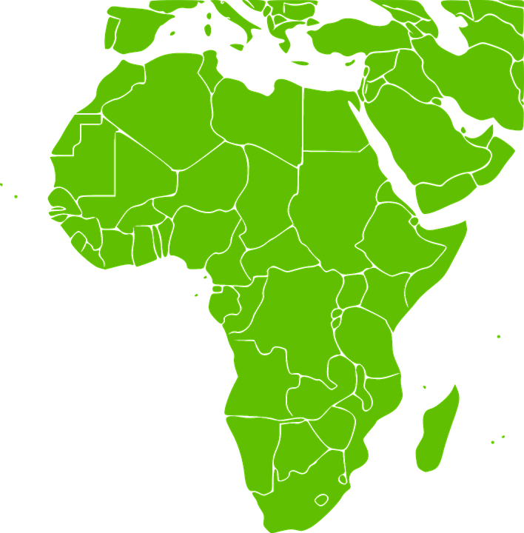
Yintoni eyaziwayo malunga nolwaluko lwamadoda kunye nokhuseleko lwe HIV?
Amaziko amathathu (3) ofundo lophando asandula ukuhlola ukuba ulwaluko lwasesibhedlele lwamadoda lungawa khusela na amadoda ukufumana intsholongwane ka gawulayo ngokwabelana ngesondo.
Notes:
Lomaphando aquke amadoda angaphezulu ku 10,000 asuka eKenya, Uganda kunye naseMzantsi Afrika.

Slide 5
Uphando lufumanise ukuba amadoda awolukileyo amalunga nesiqingatha anako ukosuleleka nje ngamadoda angolukanga. Ngamanye amagama, ulwaluko lufunyaniswe lusebenza kangange 50% ukukhusela amadoda kwintsholongwane kagawulayo.
Yintoni eyaziwayo malunga nolwaluko lwamadoda kunye nokhuseleko lwe HIV?
Notes:
Enye indlela yokuchaza oku, kukuba cinga ngamadoda ali 10 anga fumana intsholongwane ka gawulayo ngenxa yokwabelana ngesondo bengazikhuselanga kunye nomfazi osuleleke yintsholongwane ka gawulayo. Abanye baladoda alishumi, ulwaluko lulindeleke ukuba lukhusele aba 5 ekufumaneni intsholongwane ka gawulayo.

Slide 6
Ulwaluko lwamadoda lwasesibhedlele ngeyona ndlela ichanekileyo yokunciphisa amathuba okufumana intsholongwane kagawulayo. Nangona kunjalo, ulwaluko alusiniki ukhuseleko olupheleleyo lokuzikhusela kwi ntsholongwane ka gawulayo. Ngenxa yoku, ulwaluko lumele lisetyenziswe ukongezelela kwezinye indlela ezaziwayo zokukhusela intsholongwane ka gawulayo, kuquka ukusebenzisa ikhondoms ngendlela eyiyo rhoqo.
Yintoni eyaziwayo malunga nolwaluko lwamadoda kunye nokhuseleko lwe HIV?

Slide 7
Yintoni enye eyaziwayo ngolwaluko lwamadoda?
Ulwaluko lwamadoda aliwakhuseli abafazi ekufumaneni iHIV.
Amadoda ane HIV olukileyo anako ukuyidlulisa iHIV kumaqabane abo.
Notes:
Kukho enye into ebalulekileyo malunga nolwaluko lwamadoda ekumele amadoda kunye nabafazi abamele bayazi.
Ngokwenyani, maninzi amathuba indoda ingadlulisa iHIV kwiqabane lakhe, emveni kokuba yelukile, ngaphambi kokuba inxeba liphole.

Slide 8
Yintoni enye eyaziwayo ngolwaluko lwamadoda?
Ngenxa yoku, amadoda asandula ukwaluka kufuneka bame balinde ukuze inxeba liphile ngokupheleleyo phambi kokuba abelane ngesondo.

Slide 9
Ukuba unemibuzo okanye ufuna ulwazi oluphangaleleyo, nceda uhambele ikliniki yophando

